Slide 1
RPL22L1 MDM4 splicing validation project

Slide 2
Agenda
Discuss paper timeline and essential data needed
Review current data
Determine remaining experimental goals
Assign remaining experimental tasks

Slide 3
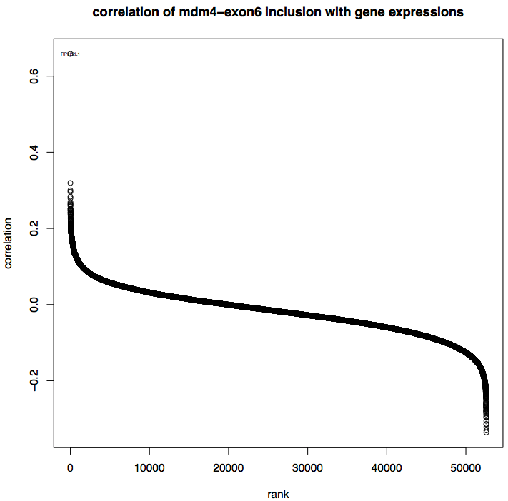
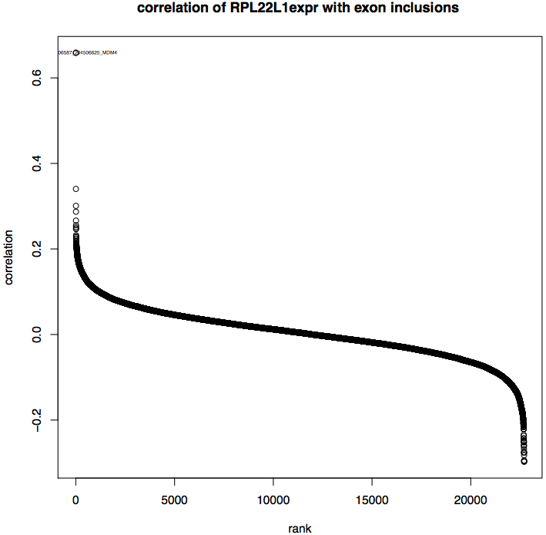
High RPL22L1 expression correlated with MDM4 exon 6 inclusion
(Mahmoud Ghandi)

Slide 4
Current model
RPL22L1
p53
cell survival
MDM4-FL
MDM4-S
p53
cell death
RPL22 ----
RPL22L1

Slide 5
Status update
Gain and loss of function experiments:
Tested 3 shRNAs targeting RPL22L1 (Michael Mai Brent
RPL22L1 overexpression (Maria, Franklin)
Phenotypic readouts:
Splicing changes - qPCR
Western blot MDM4 and RPL22L1
Cell viability - colony formation
Previous data:
semi-quantitative RT-PCR

Slide 6
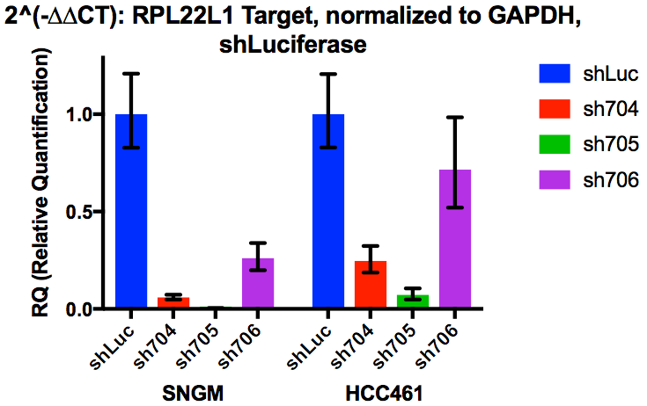
Identified shRNAs that can suppress RPL22L1
MDM4-L, RPL22L1ko-sensitive, MDM4ko-sensitive
MDM4-L, RPL22L1ko-resistant, p53 mut

Slide 7
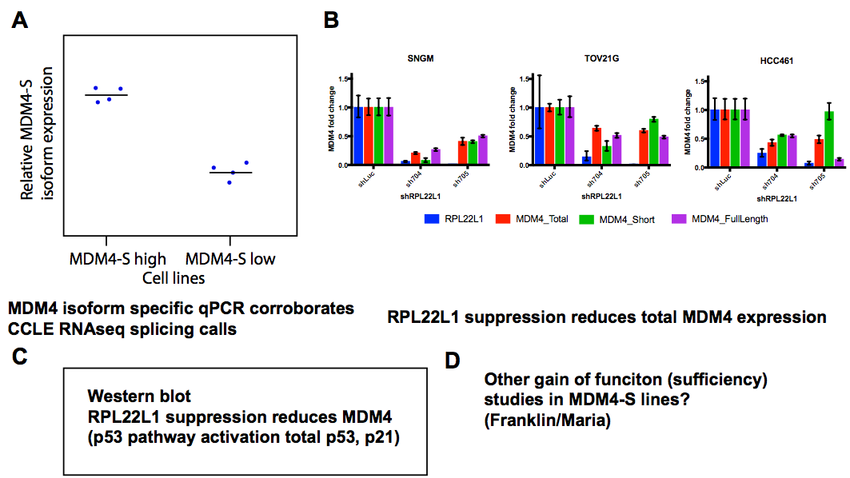
Figure mock up

Slide 8
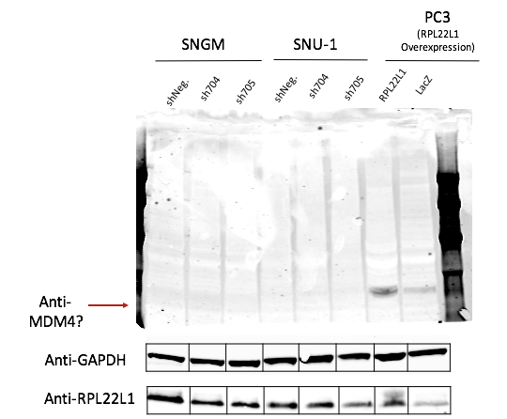
RPL22L1 suppression western day 3 (Trial 1)
MDM4 Ab: https://www.sigmaaldrich.com/catalog/product/sigma/m0445?lang=en&region=US

Slide 9
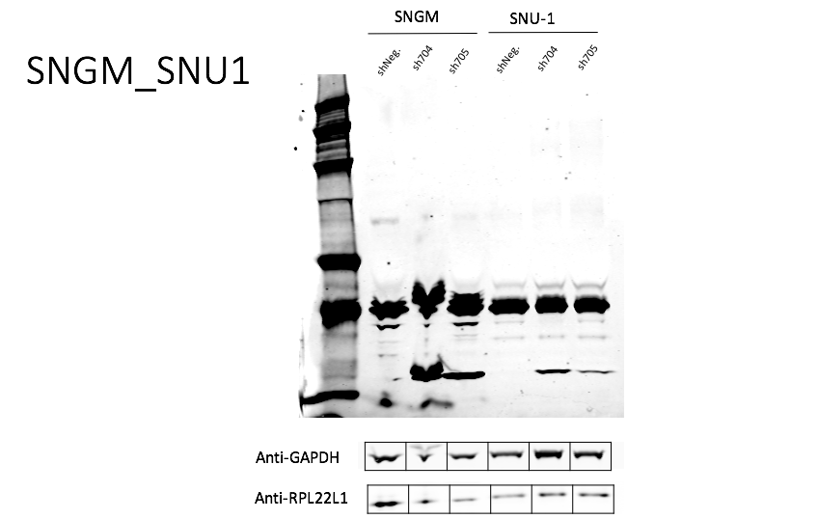
RPL22L1 suppression western day 3 (Trial 2)
MDM4 Ab: https://www.sigmaaldrich.com/catalog/product/sigma/m0445?lang=en&region=US
kDa
250
150
100
75
50
37
25
MDM4 total?
Anti-MDM4
MDM4-S or novel isoform?
Consider following paper:
https://www.ncbi.nlm.nih.gov/pmc/articles/PMC2699833/

Slide 10
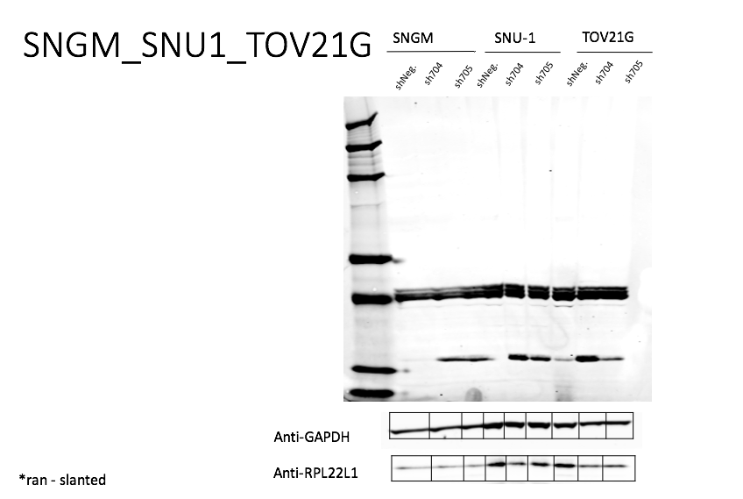
RPL22L1 suppression western day 3 (Trial 1)
MDM4 Ab: https://www.sigmaaldrich.com/catalog/product/sigma/m0445?lang=en&region=US
kDa
250
150
100
75
50
37
25
No MDM4 total detected
Anti-MDM4
MDM4-S or novel isoform?
Consider following paper:
https://www.ncbi.nlm.nih.gov/pmc/articles/PMC2699833/

Slide 11
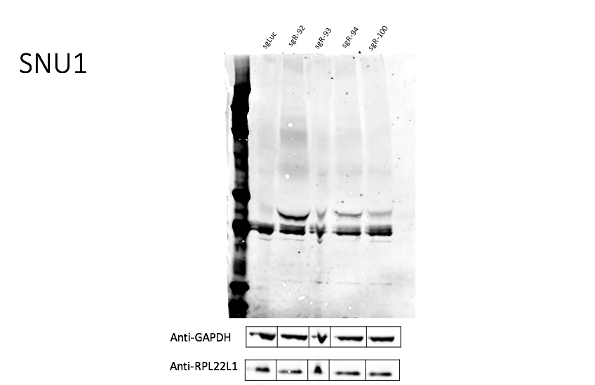
RPL22L1 suppression western day 3 (Trial 1)
MDM4 Ab: https://www.sigmaaldrich.com/catalog/product/sigma/m0445?lang=en&region=US
kDa
250
150
100
75
50
37
25
sgRNA testing, no RPL22L1 knockout observed by western
Different MDM4 isoform upregulated with CRISPR
Anti-MDM4
Weak bands at approximate size of MDM4 isoform from shRPL22L1 experiments

Slide 12
In progress
Establish baseline MDM4-S and MDM4-L to validate CCLE RNAseq
Normalizing shRPL22L1 qPCR inputs for biological replicates
Repeat of MDM4 western with more protein
RPL22L1 overexpressing cell lines by western blot?

Slide 13
Maria slides?
RPL22L1 Knockdown
SW1573
•qPCR
LNCaP
•Focus Formation Assay
•Pellet for RNA extraction/cDNA/qPCR
SW48
•Focus Formation Assay
•Pellet for RNA extraction/cDNA/qPCR
•Western Blot
RPL22L1 Overexpression
22RV1
•Pellet for RNA
•Western Blot
PC3
•Pellet for RNA
•Western Blot
VCAP
•Pellet for RNA
•Western Blot
293T
OVISE
OVSAHO

Slide 14
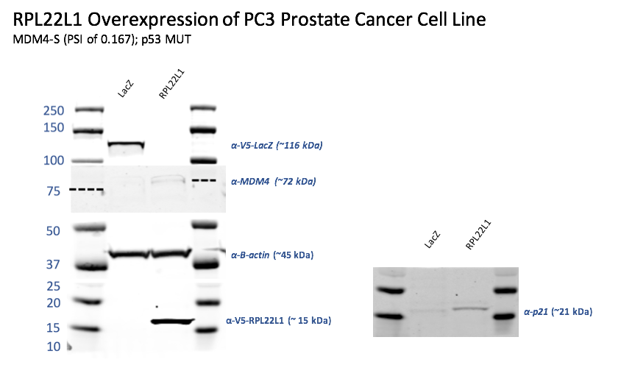

Slide 15
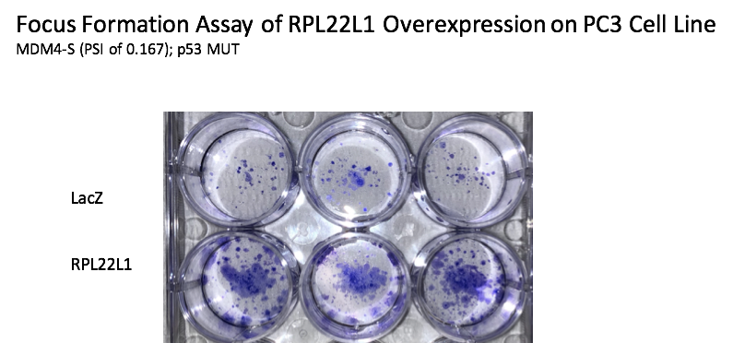

Slide 16
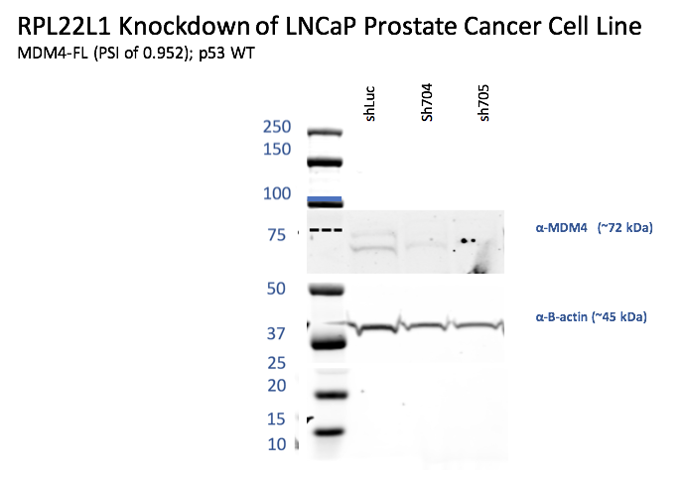

Slide 17
Discussion Conclusions/Key goals?

Slide 18
Old slides

Slide 19
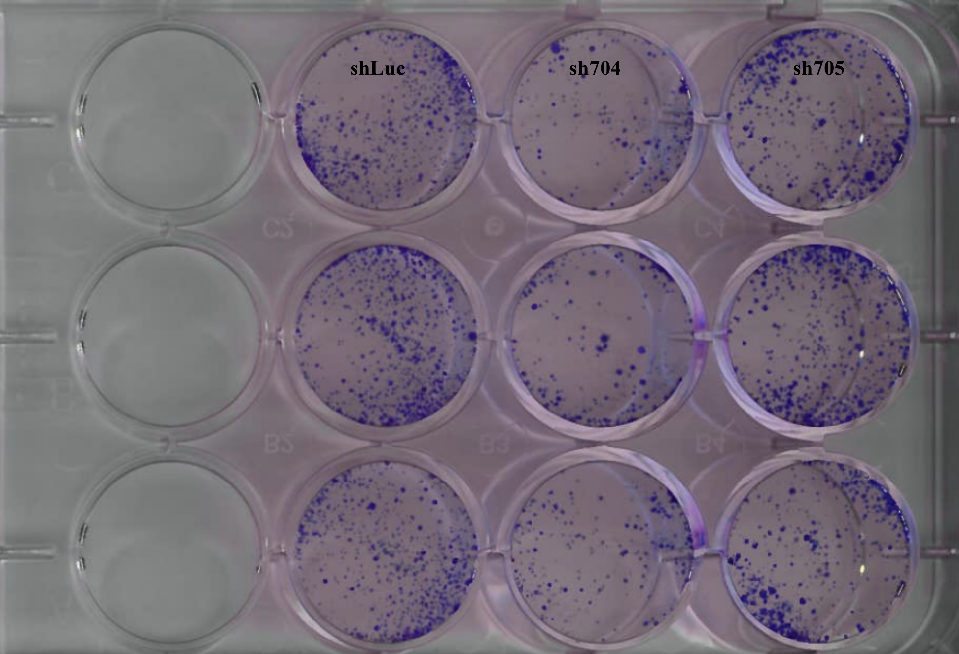
FFA SW-48 Knockdown

Slide 20
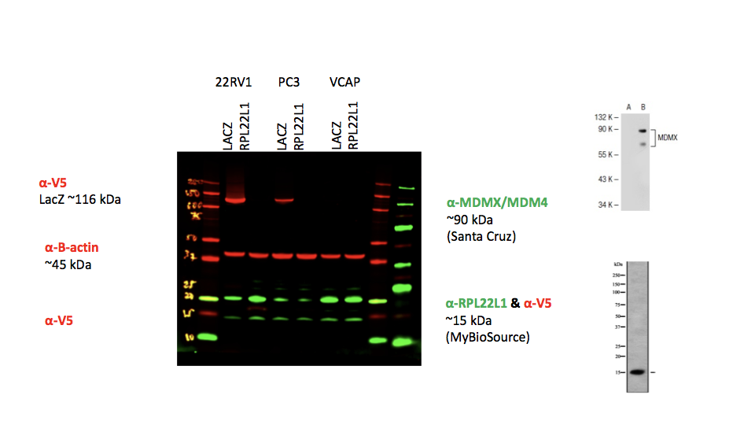
Western Blot ORF Lysates

Slide 21
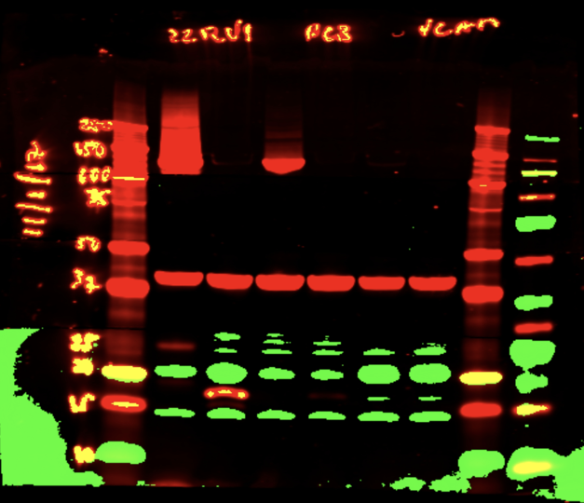

Slide 22
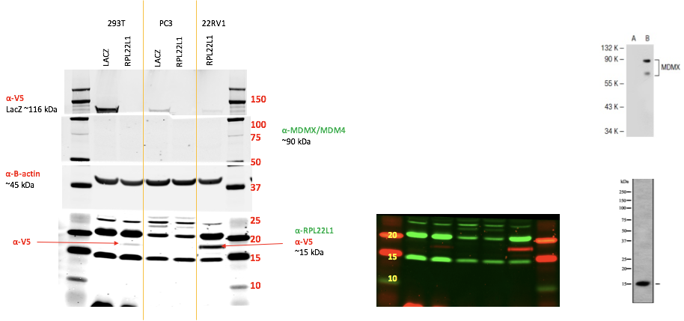
Notes:
2 bands for RPL22L1?

Slide 23
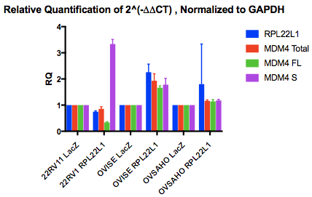

Slide 24
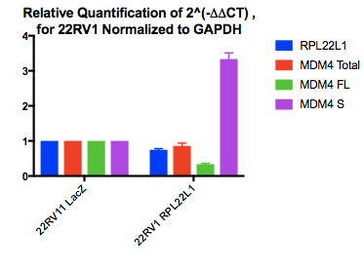
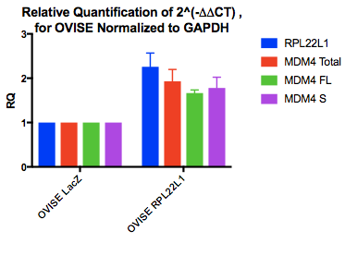
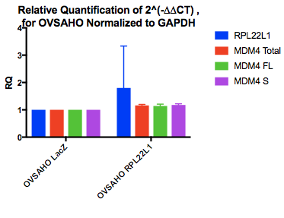
Notes:
22RV1 MDM4-FL, RPL22L1 6.0, P53 MUT
OVISE MDM4-S, RPL22L1 low, RPL22 high
OVSAHO MDM4-S, RPL22L1 3.6

Slide 25
Useful cell line info
cell lines assayed and molecular features

Slide 26
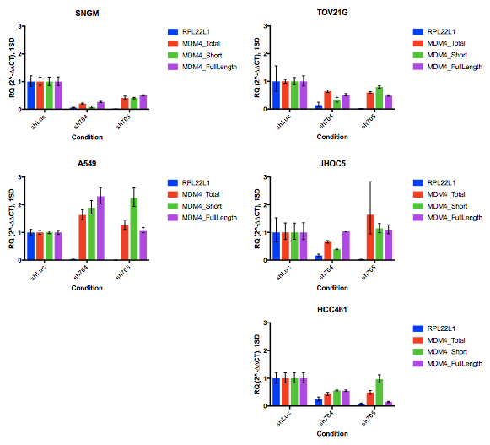
SNGM, HCC461, HT144, TOV21G and A549 Combined
error bars = 1 Standard Deviation
Doubly Dependent
Doubly Dependent
Doubly Not-Dependent
MDM4 Dep. Not RPL22L1 Dep
MDM4 Dep. Not RPL22L1 Dep
Notes:
Look at ratios for qPCR
P53 mutant lines may have more of a MDM4 splicing response because they don’t have dependency
Check the
Western on the 2 lines after a new antibody
Validate the MDM4 hih FL expression levels across cell lines at baselin
Panel knockdown panel for western

Slide 27
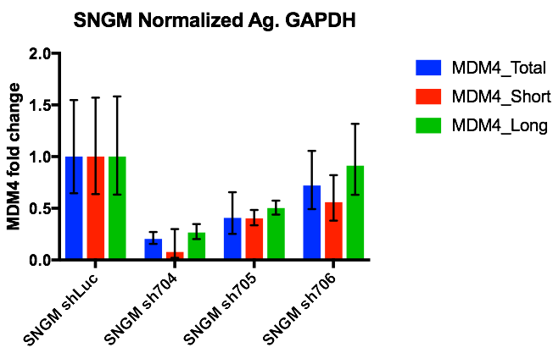
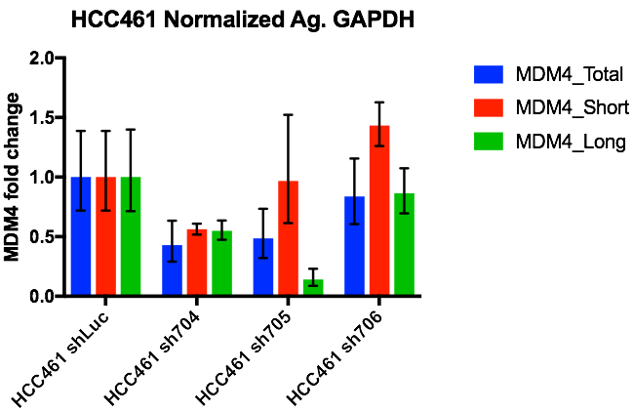
RPL22L1 suppression reduces total MDM4 expression

Slide 28
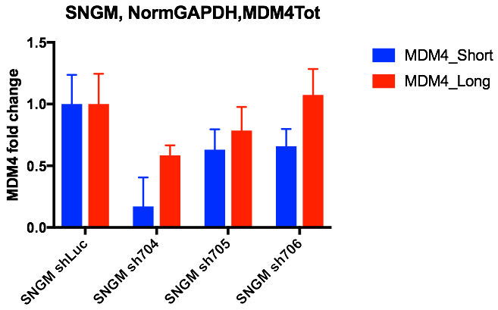
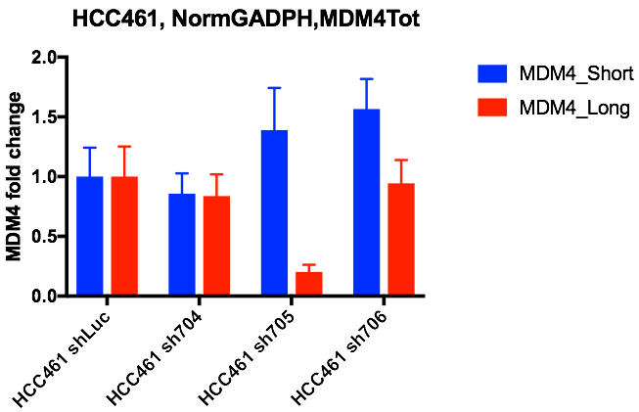
Less clear impact on MDM4 isoform switching

Slide 29
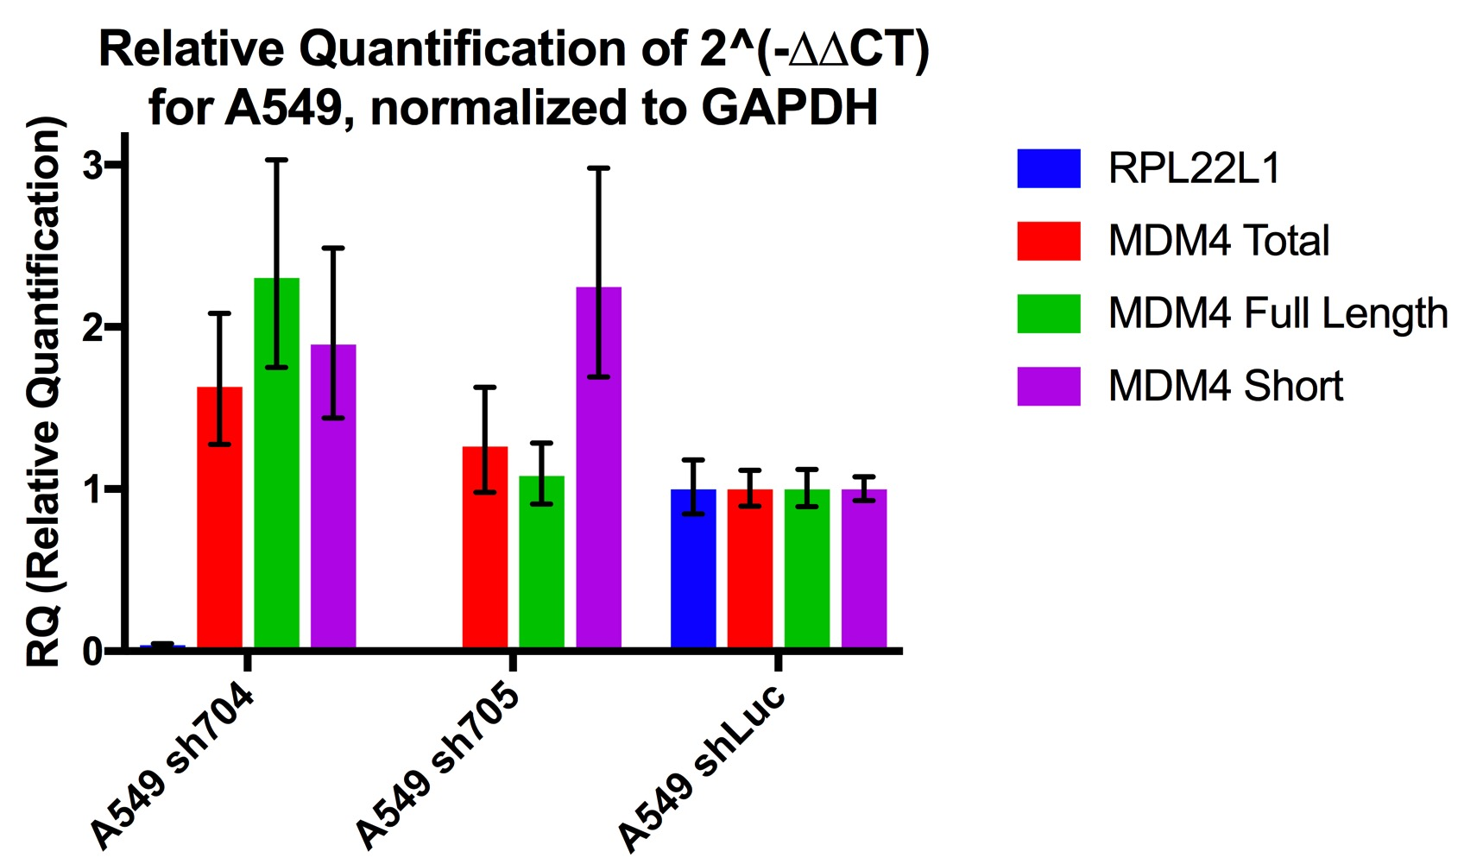
MDM4 Isoform trends in A549, JHOC5, and TOV21G at 72hr

Slide 30
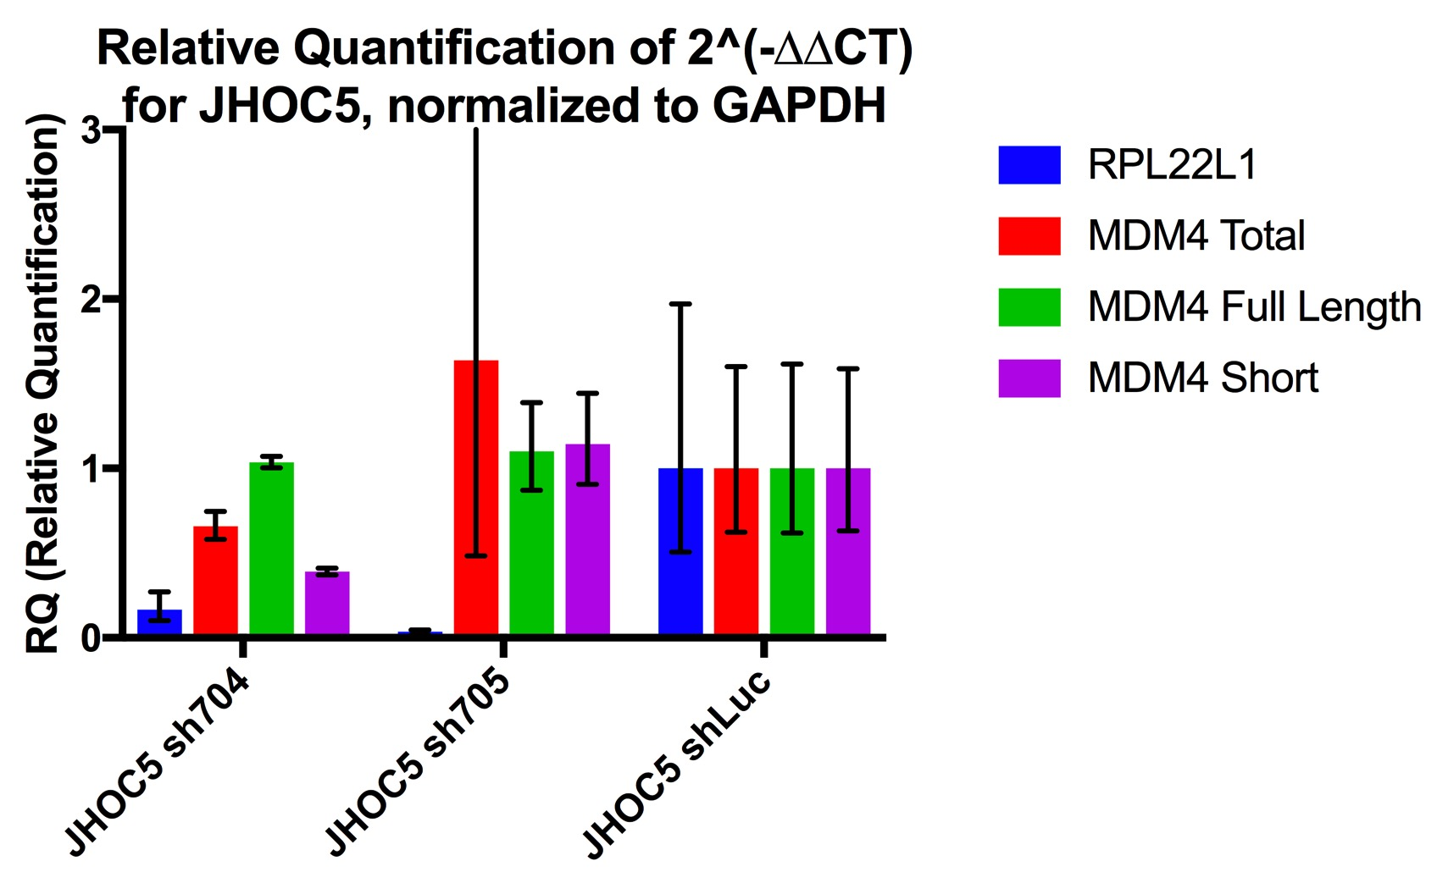
MDM4 Isoform trends in A549, JHOC5, and TOV21G at 72hr

Slide 31
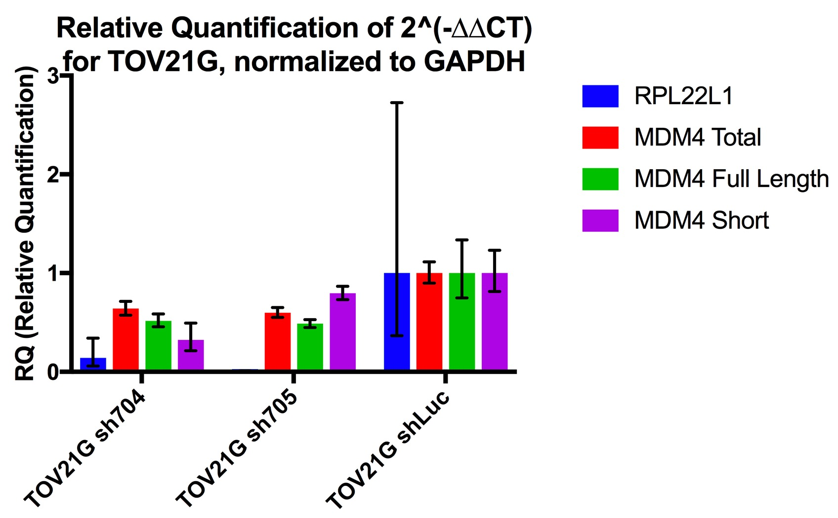
MDM4 Isoform trends in A549, JHOC5, and TOV21G at 72hr

Slide 32
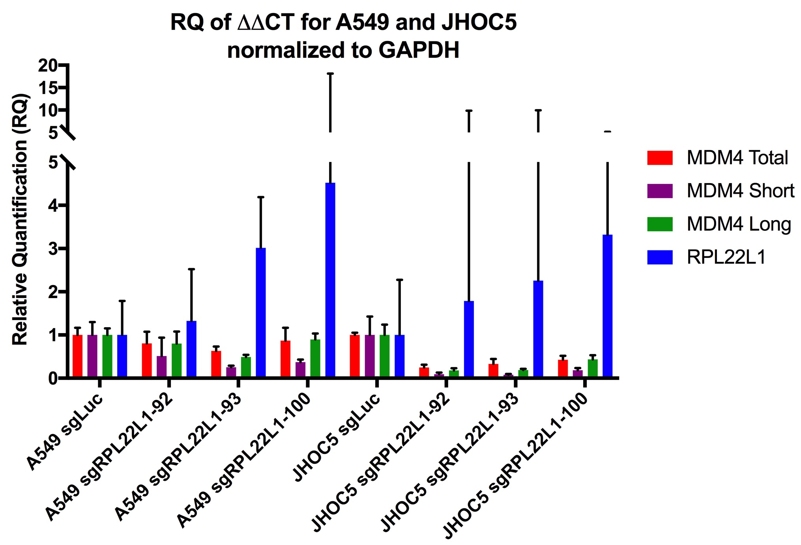

Slide 33
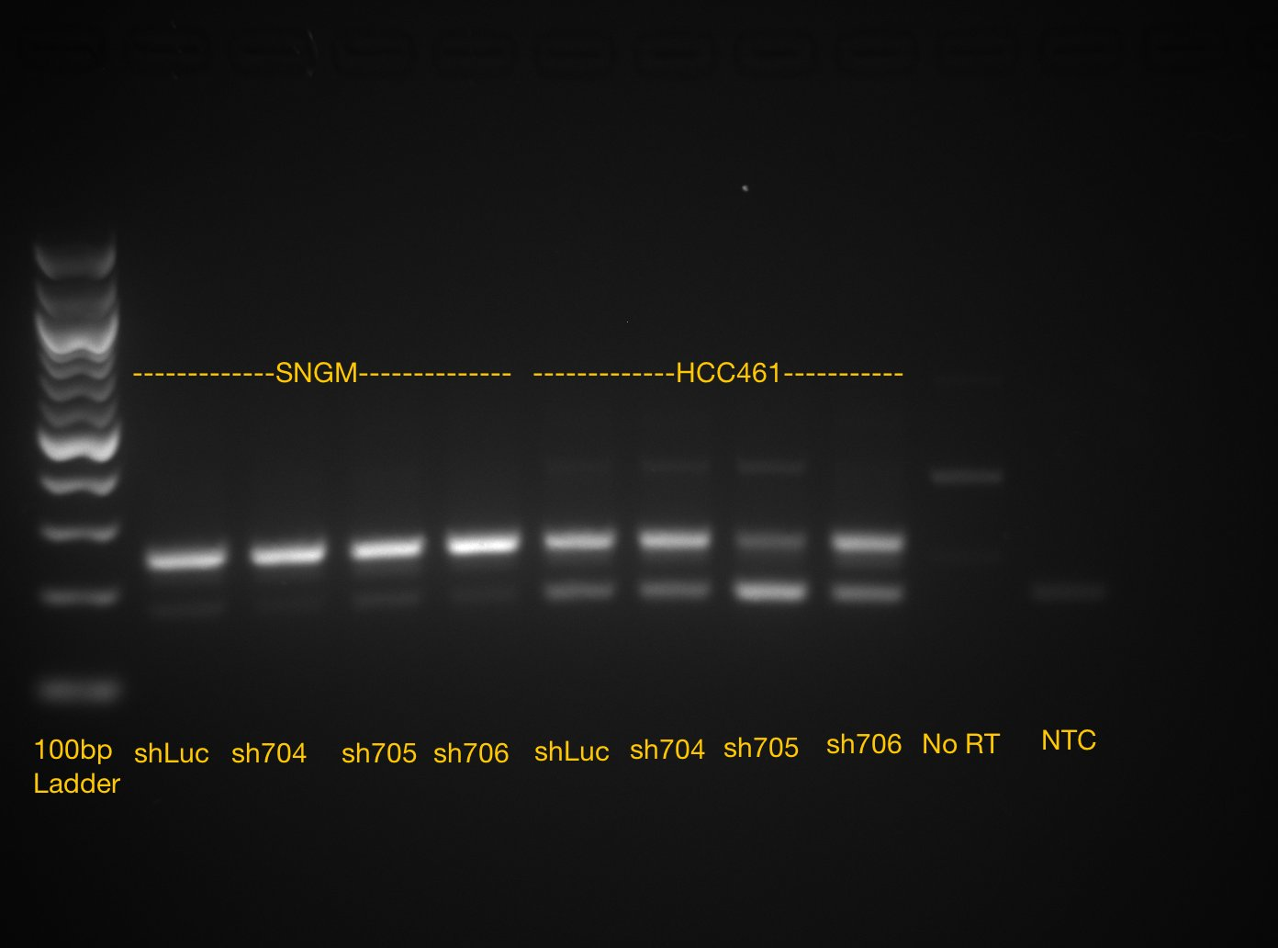
Semi-quantitative RT-PCR can detect MDM4 splicing alterations
Further optimization is needed
40 cycles

Slide 34
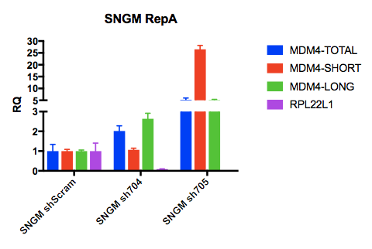
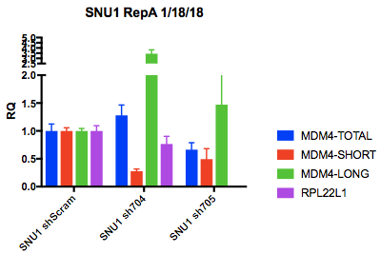
qPCR SNGM, SNU1 20180118
Note: large amplification difference between samples for GAPDH (housekeeping control)

Slide 35
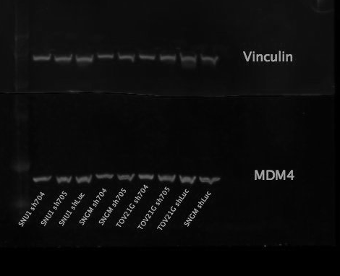
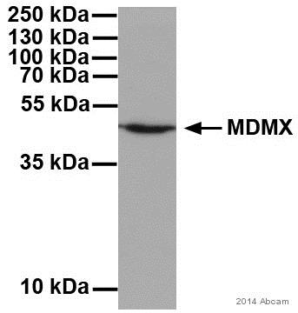
Western on SNGM, SNU1, TOV21G 20171221
Abcam MDMX Antibody 82

Slide 36
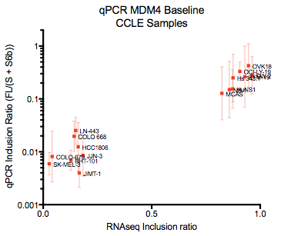
CCLE qPCR Results correlate with RNAseq (16 samples)

Slide 37
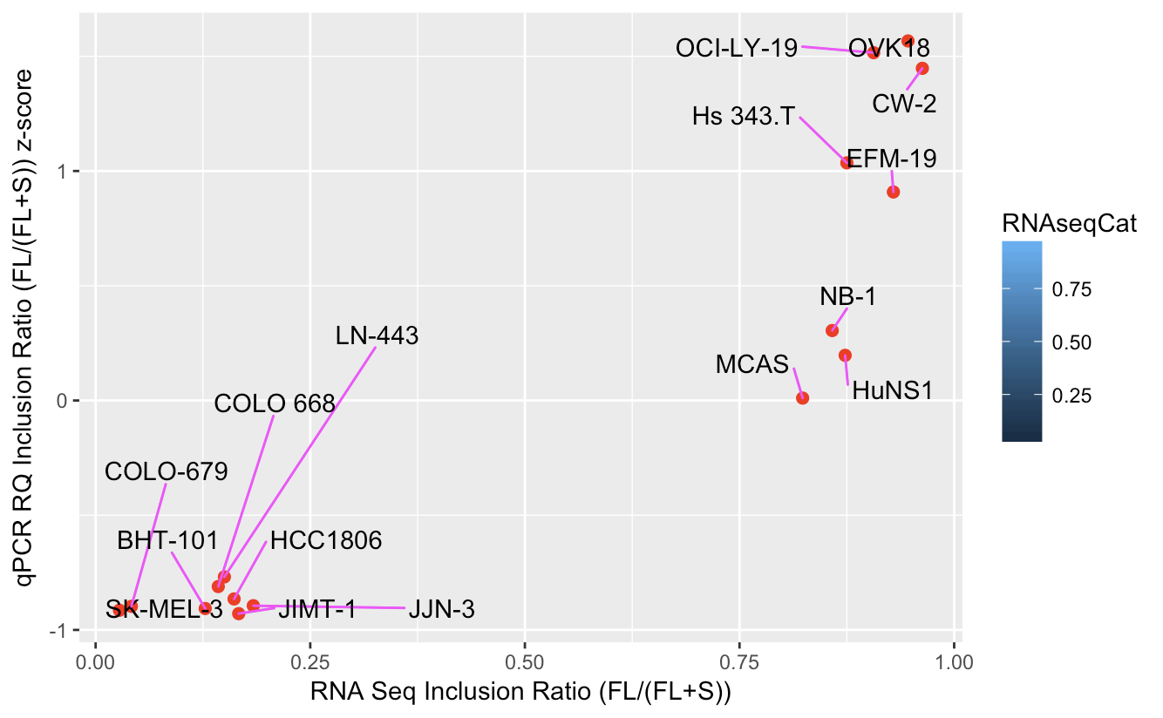
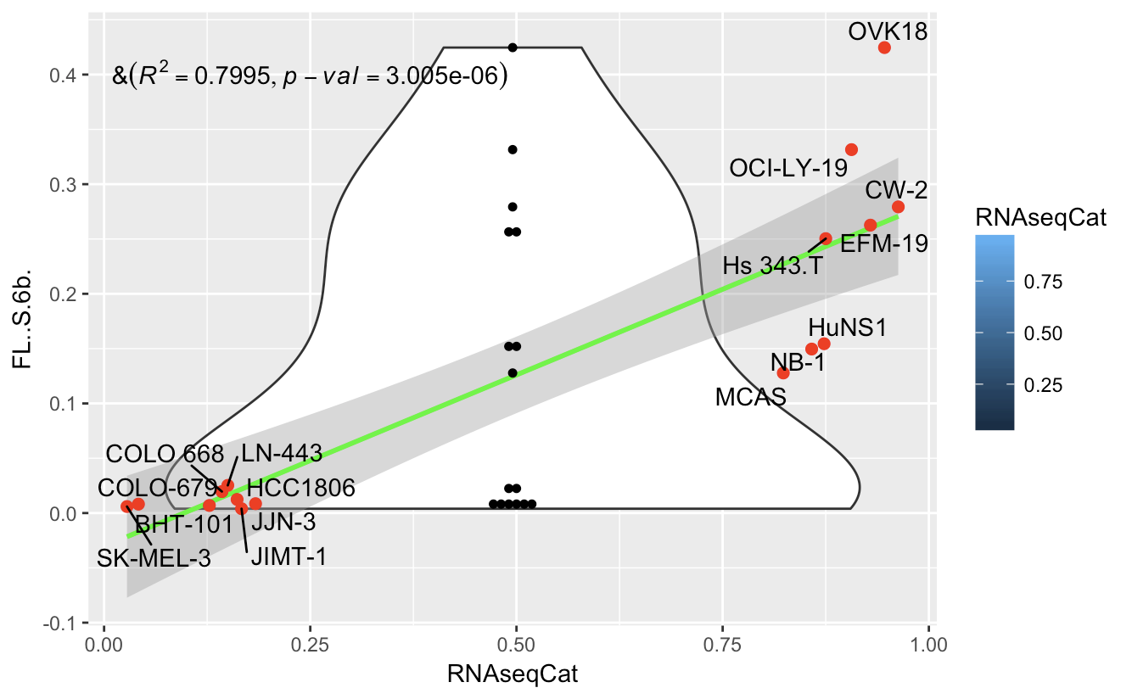
CCLE qPCR Results correlate with RNAseq (16 samples)
FL/(S+6b)

